Slide 1


Common Logical Errors in C and How to Fix Them
Understand mistakes • Write safer code • Debug confidently
Madan Baswante - 1262253829
Ved Konda - 1262254011
Manesh M Nair – 1262251400
Joel Jose - 1262251283
Noel Roy - 1262250963

Slide 2
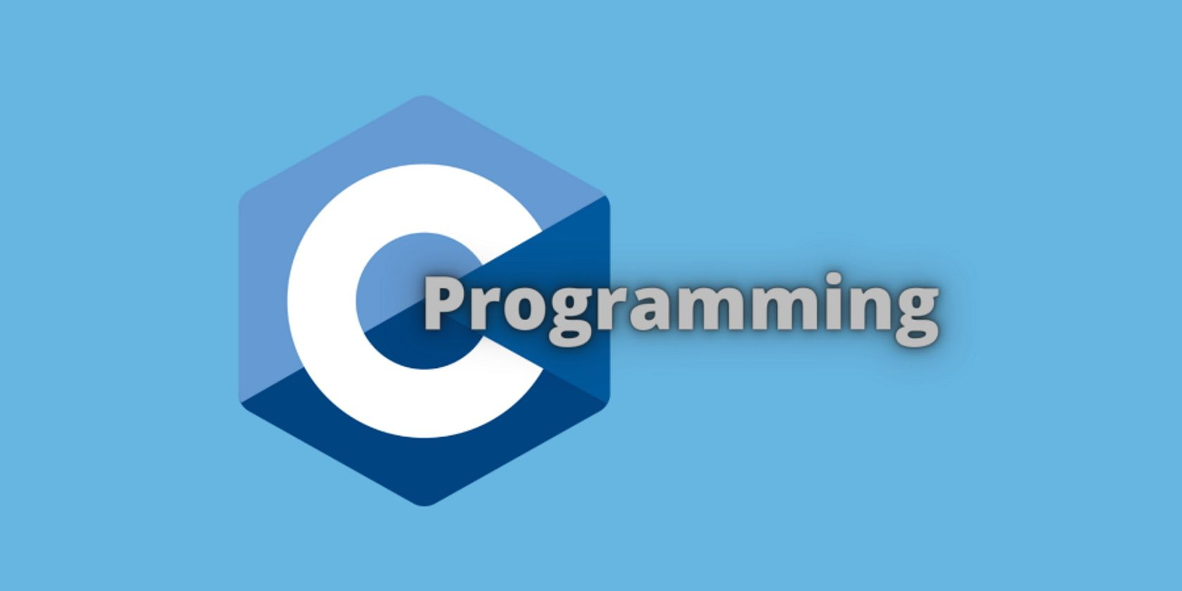
Introduction
C is a powerful and widely used programming language
It gives programmers low-level control and high performance
Small logical mistakes in C can lead to major program errors
Logical errors do not produce compilation errors
Programs run successfully but give incorrect output
Understanding common logical errors improves debugging skills
Helps in writing efficient, reliable, and error-free programs

Slide 3
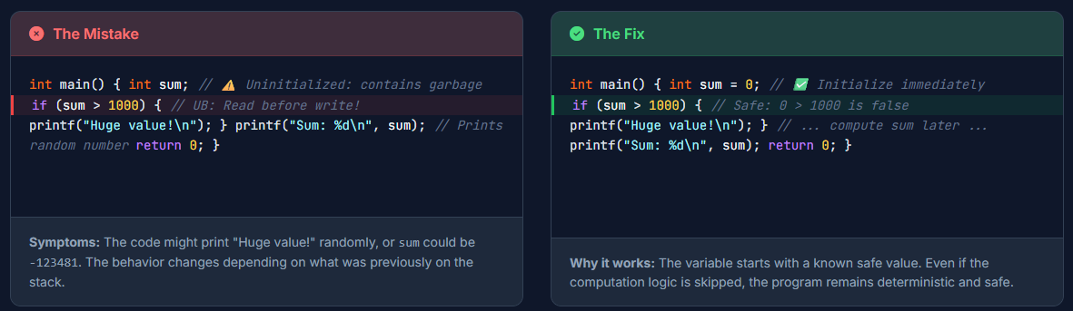
Not Initializing Variables
Not Initializing Variables
Happens when a variable is declared but not assigned an initial value
Such variables contain garbage or random values from memory
Using them leads to unexpected and incorrect program output
Compiler does not show an error, making the mistake hard to detect
Common in loops, counters, sum variables, and decision flags
May cause logical errors even when the syntax is correct
Results vary every time the program runs
Fix: Always initialize variables at the time of declaration

Slide 4
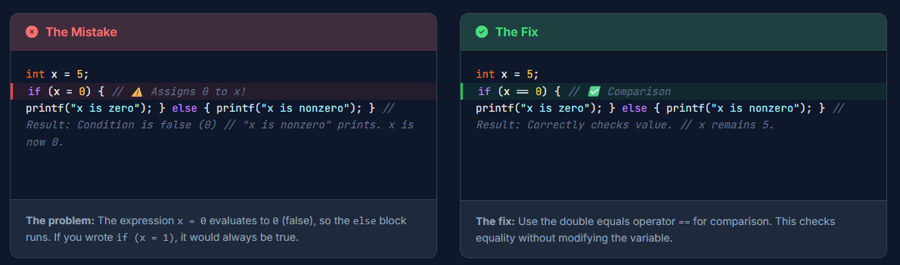
Using = Instead of ==
Using = Instead of ==
Occurs when assignment operator (=) is used instead of comparison (==)
Assignment changes the variable value instead of checking equality
Condition like if (x = 5) always evaluates to true
Causes incorrect decision-making in if, while, and for statements
Program logic breaks without any compilation error
Very difficult to detect by just looking at output
Leads to wrong program flow and unexpected results
Fix: Use == for comparison and = only for assignment

Slide 5
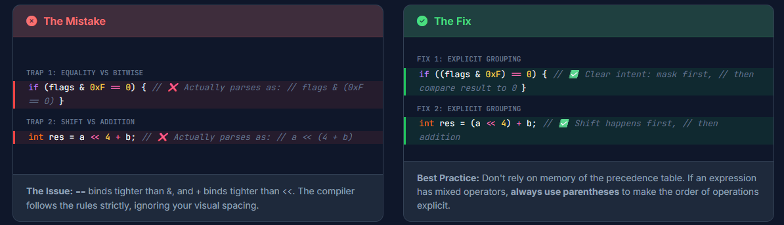
Wrong Operator Precedence
Occurs when programmer assumes operators execute left to right
C follows specific operator precedence rules
Some operators execute before others (e.g. * before +)
Expressions may produce results different from expectation
Logical conditions may behave incorrectly
Code becomes confusing and error-prone
Reduces readability and increases chances of bugs
Fix: Use parentheses to clearly define order of execution

Slide 6
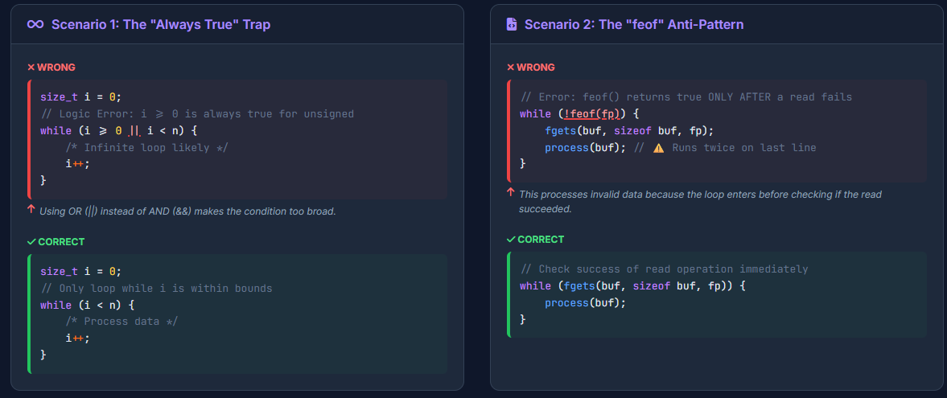
Incorrect Loop Conditions
Happens when loop condition does not match intended logic
May cause infinite loops or loops that never execute
Error may occur in initialization, condition, or increment/decrement
Program may hang or terminate incorrectly
Logical error not detected by compiler
Affects program performance and correctness
Fix: Carefully verify loop start, condition, and update

Slide 7
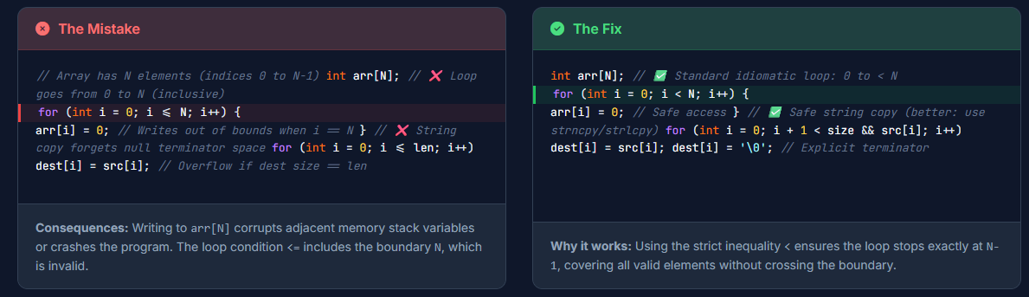
Off-by-One Error
Occurs when a loop runs one extra or one fewer time
Very common while working with arrays
Array indexing in C starts from 0
May access invalid memory locations
Produces incorrect results or runtime errors
Hard to identify in large loops
Fix: Double-check loop boundaries and index values

Slide 8
Conclusion
Logical errors do not stop program execution but produce incorrect results
Most logical errors occur due to small mistakes in conditions and loops
Understanding common errors helps in faster debugging
Writing clear and readable code reduces chances of logical mistakes
Proper initialization and correct operators improve program reliability
Practice and careful code review are key to becoming a better C programmer
Avoiding logical errors improves program reliability. Thank You! 🚀

